Slide 1





TaskHup
Presented by
Nrmeen Mohamed
Noha Teaima
Nadine Mohamed
Mariam Mohamed
Kloud Fayed
Ahmed Elwazer
Mohamed Ayman

Slide 2

Features Overview
01
02
03
04
Task Management (Add, edit, delete tasks easily).
Task Categories (🏠 Personal, 🏢 Work, 🛒 Shopping).
Task Priorities (🔴 High, 🟡 Medium, 🔵 Low).
Reminders & Notifications (Push notifications to keep users on track).

Slide 3

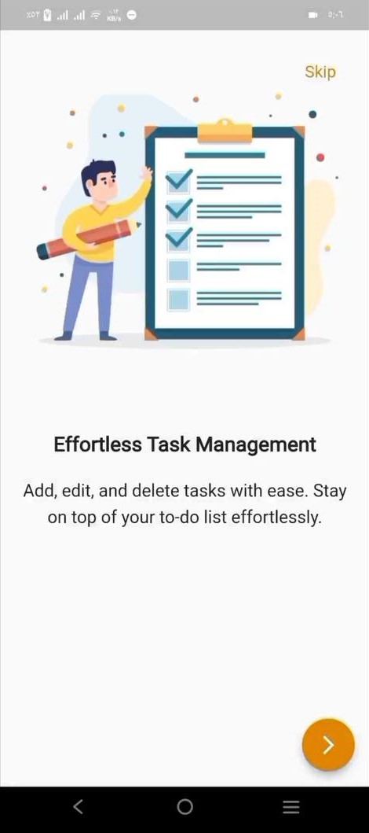
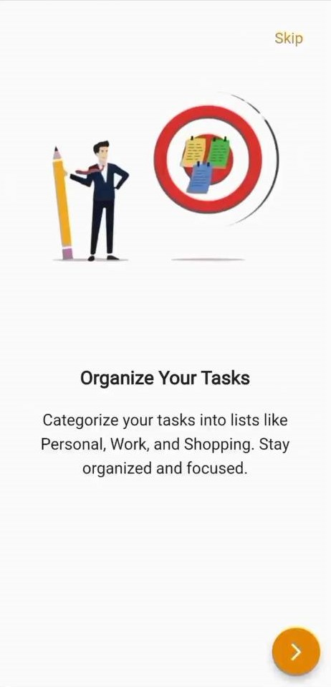
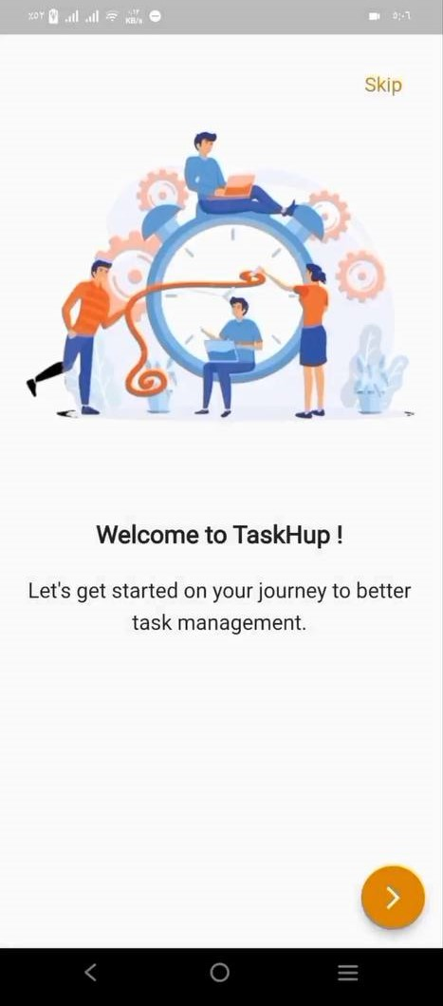
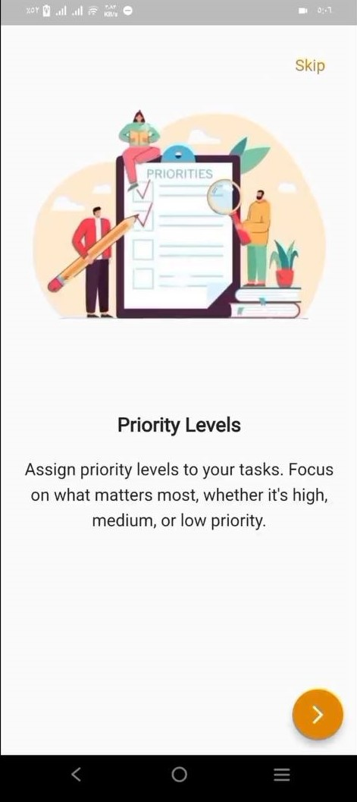
Onboarding Screens

Slide 4
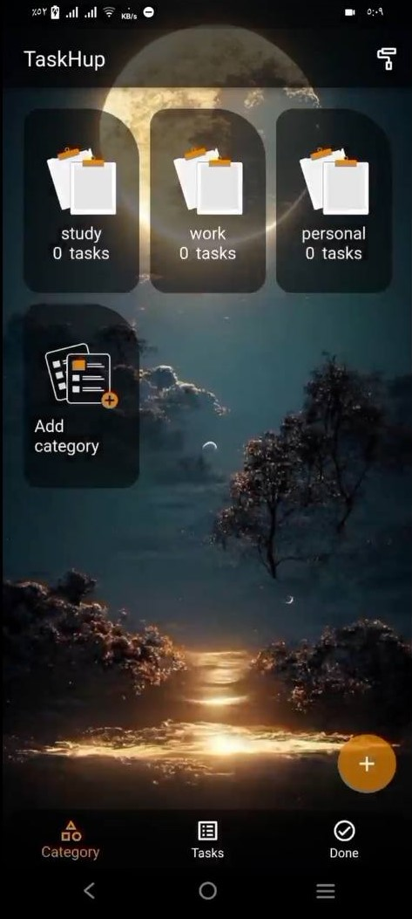
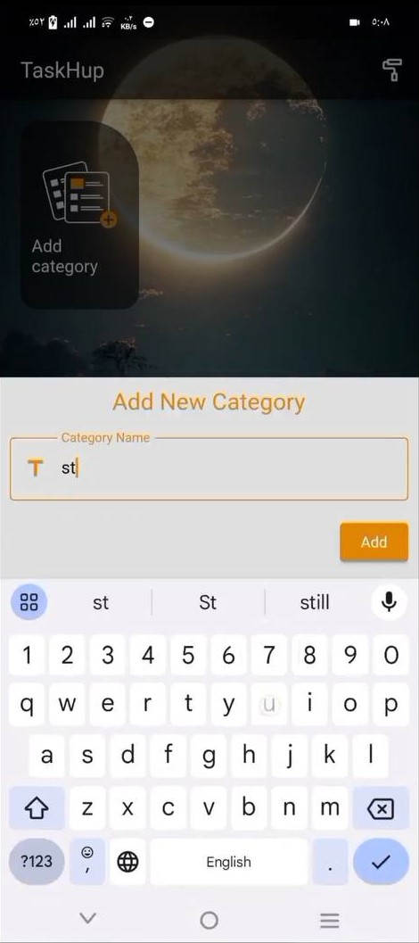
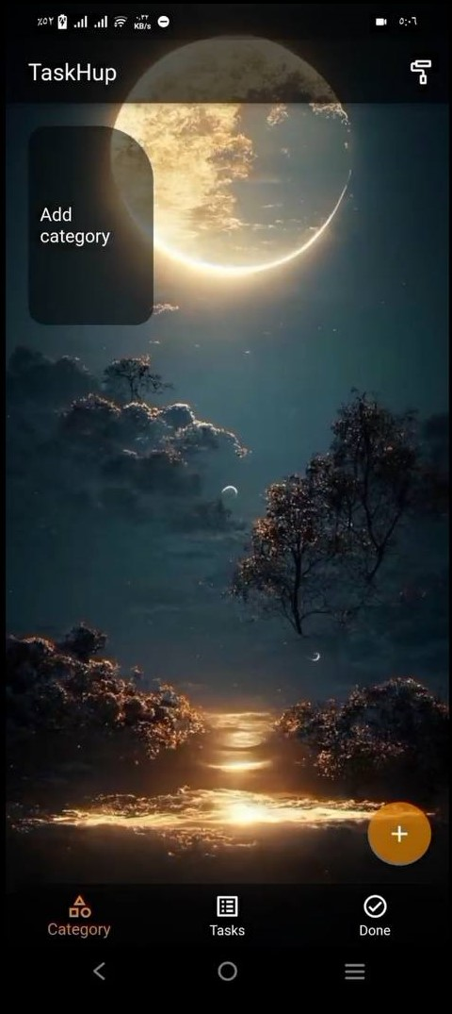
Category Screen
After adding
categories

Slide 5
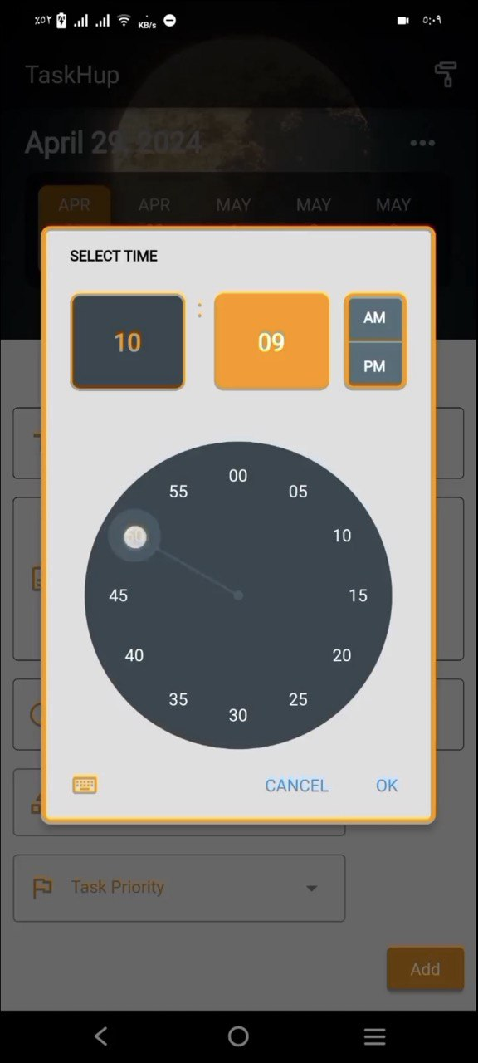
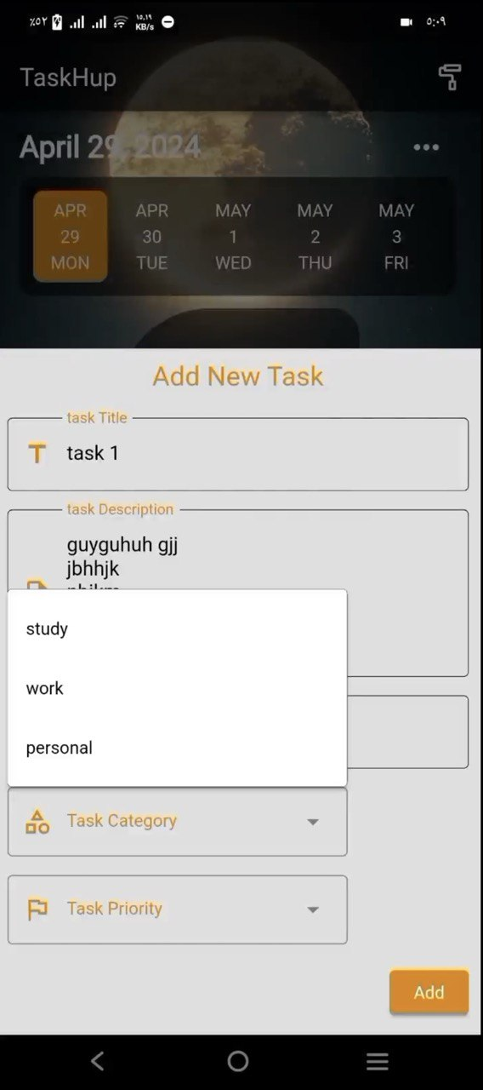
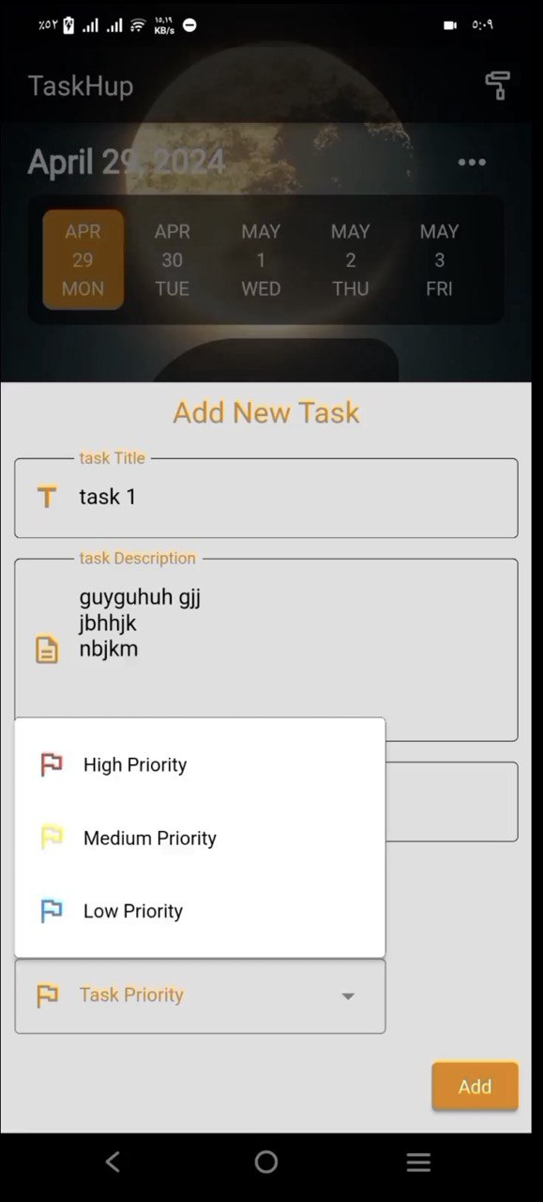
Add Task Screen

Slide 6
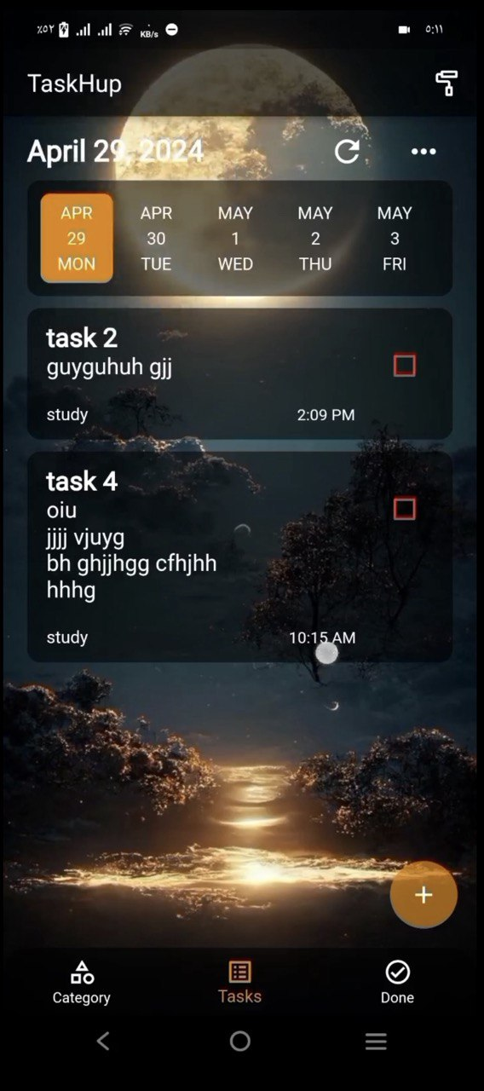
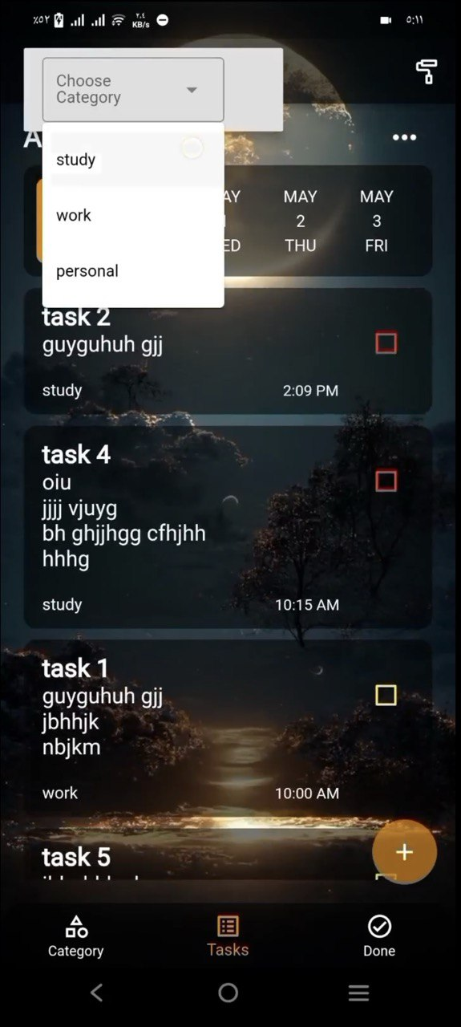
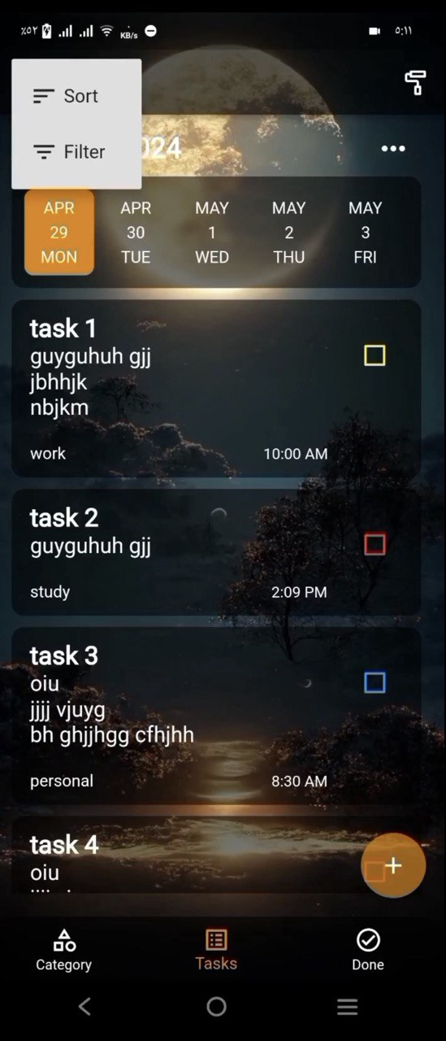
Tasks Screen

Slide 7
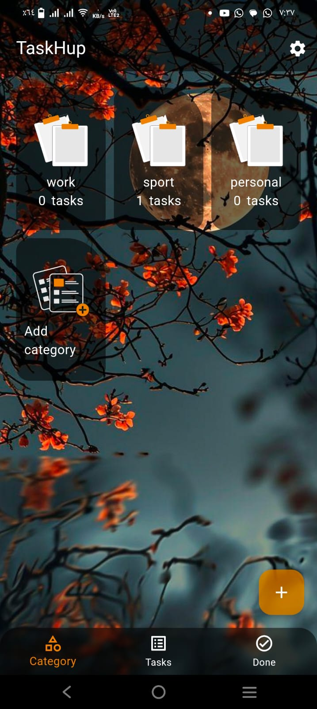
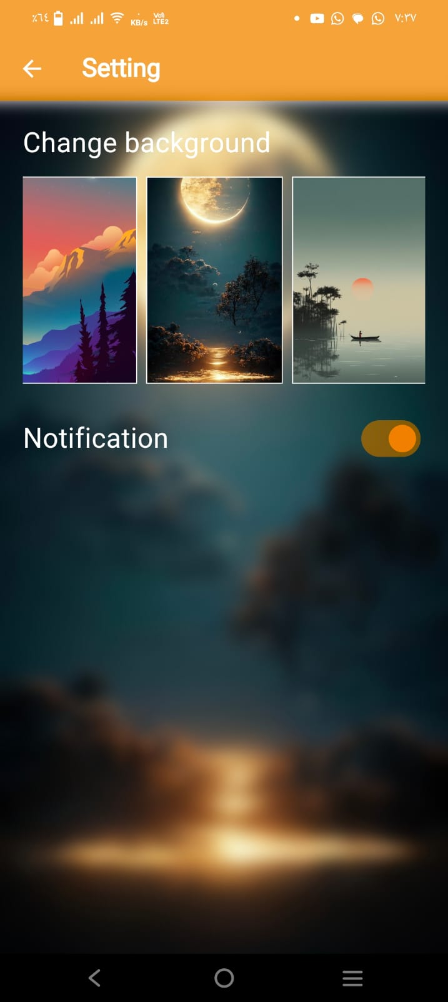
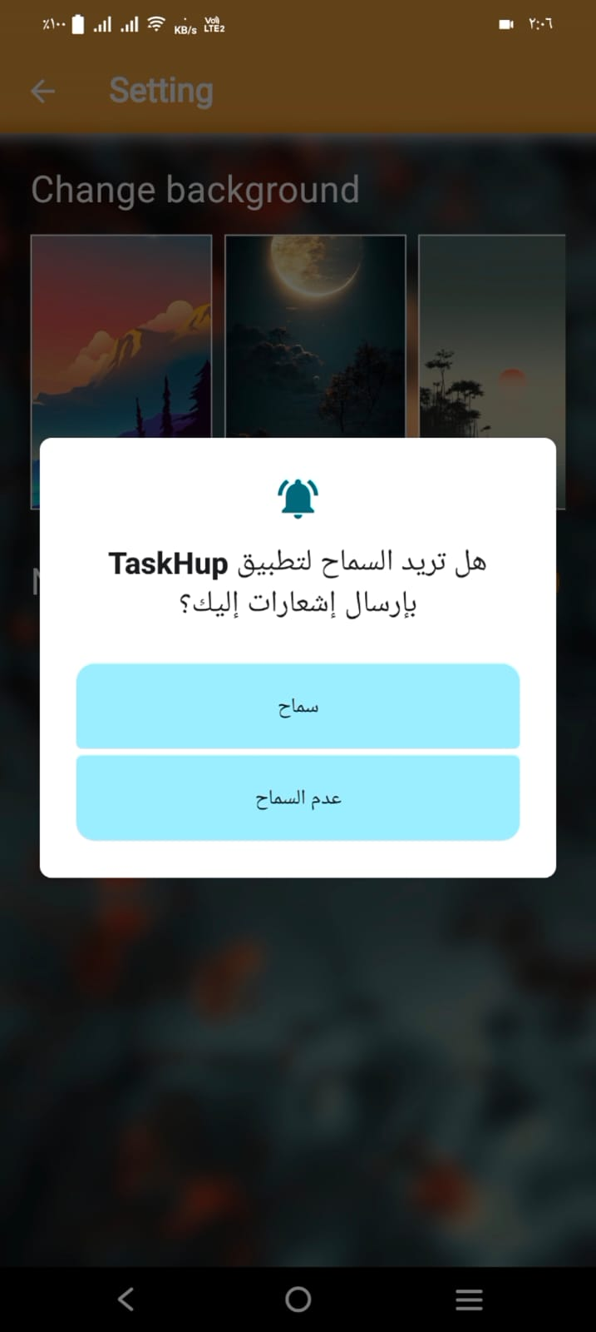
Settings Screen

Slide 8

01.
bloc & flutter_bloc
Manages state and business logic, ensuring a structured and maintainable architecture.
04.
flutter_local_notifications
Displays scheduled notifications to remind users about tasks.
02.
Key Libraries
05.
sqflite
Handles local database storage using SQLite for efficient task management.
workmanager
Executes background tasks like sending notifications even when the app is closed.
03.
shared_preferences
Saves user preferences, such as background settings, persistently.
06.
flutter_screenutil
Ensures responsive design across various screen sizes and resolutions.

Slide 9
01
Advanced Analytics for user productivity.
Future Enhancements
02
Cloud Syncing across Devices.
03
Integration with Calendar Apps.

Slide 10


Thanks For Your
Attention
www.reallygreatsite.com

